Slide 1

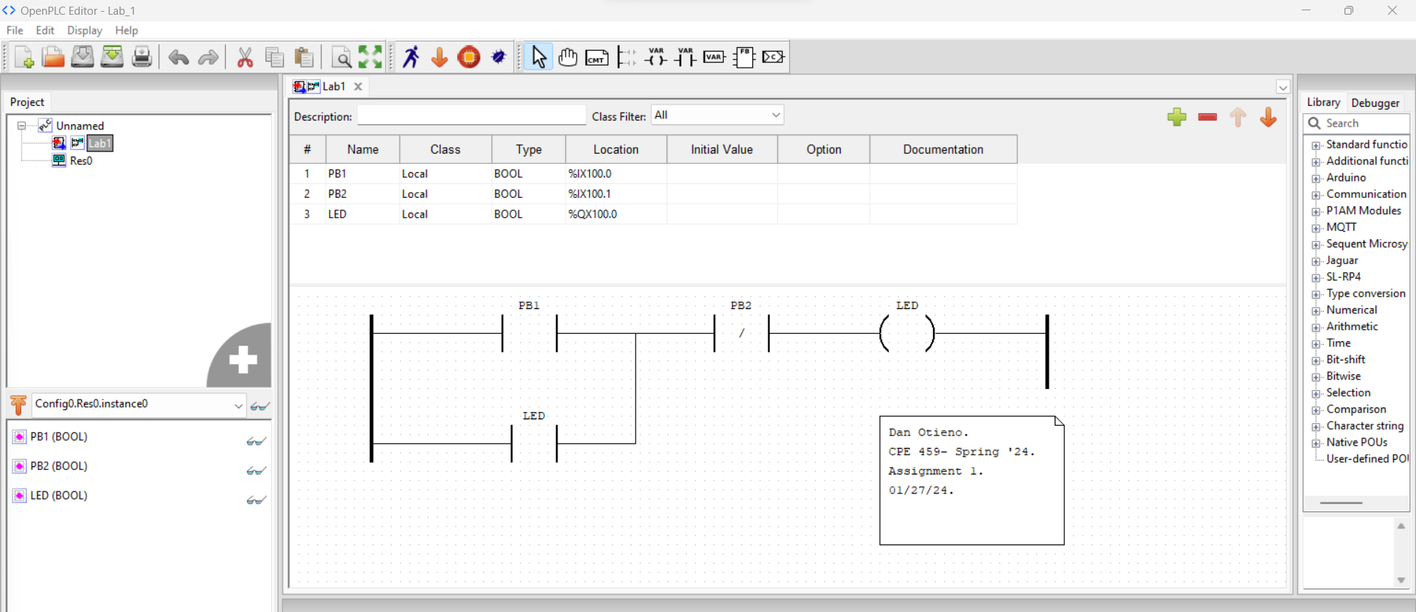
Dan Otieno.
CPE 459 – Spring 2024.
Assignment 1 – Getting started with Open PLC.
01/27/24.

Slide 2
